Slide 1
금강 역세권 신도시 개발
김주현, 이중재, 이재원, 허광호

Slide 2
Contents 1. Summary 2. Plan and related plan 3. Site Analysis 4. Case Study 5. Goals and Objectives

Slide 3
1. Summary

Slide 4

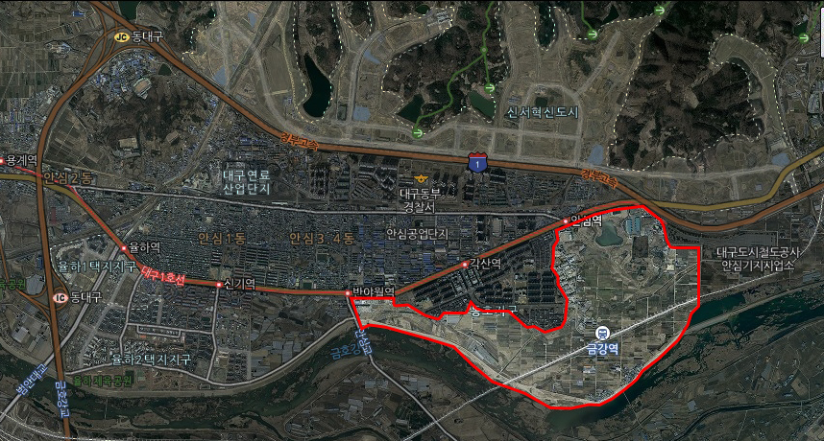
1. Summary
Scheme’s background
▌ Geumgang Station infrastructu
re left as it is
▌ Dong-gu next-generation ima
ge advancement
▌ Lack of cultural institution and
infrastructure
▌ Citizens’ dissatisfaction
with their living environment
Scheme’s excent
▌ Location: Daegu, Donggu, Gumgandong region
▌ Area: About 2km

Slide 5
2. Plan and related plan

Slide 6
2. 상위 계획 및 관련 계획
관련 계획 검토
2020 대구권 광역기본계획
2015 동구
장기발전계획
부분 관련계획
기본 구상 및 시사점 도출

Slide 7
2. High Plan and Associated plan
2020 대구권 광역 도시계획
광역계획 권 공간구조의 다핵화와 지역거점 개발
- 고속철도 및 지하철 역세권의 체계적 개발
에너지 절약적 광역계획 권 공간구조 형성
- 혼합적 토지이용과 압축도시 지향
녹지 및 수번공간의 보전과 계획적 개발
- 금호강과 낙동강 등 수변공간을 활용한 여가·위락공간의 계획적조성
주변지역의 자족적 생활기반 구축
- 업무·상업기능의 주변지역 입지유도
implication
Development of the outskirts of Geumgang Railway Station alongside coordinated and efficient strengthening of land use in between other regions
Entice installment of commercial facilities for the activity at elevated station surroundings and comfort of citizens using the Geumho River waterfront.
Notes:
Wide area system’s vacant structural and regional location development.
Systematic development of high-speed railway and subway stations
Eco-friendly Formative spacial construction of Wide-area development range
Aims of Integrated land usage and urban condensation
Systematic development of greenery and multiple spacial conservation
Geumho River, Nakdong River, etc. waterfront space used for leisure, amusement; construction and planned creation of a basis for self-sufficient living.
Outskirts location guidance for Business and commerce facilities
Suggested points
Development of the outskirts of Geumgang Railway Station alongside coordinated and efficient strengthening of land use in between other regions.
Entice installment of commercial facilities for the activity at elevated station surroundings and comfort of citizens using the Geumho River waterfront.

Slide 8
2. High Plan and Associated plan
2015 Dong Gu Long-term Development Plan VIsion
안심 부도심권
신서혁신도시건설
대구선 공원 조성
동대구 광역복합환승센터 건립
금호강 생태하천 조성

Slide 9
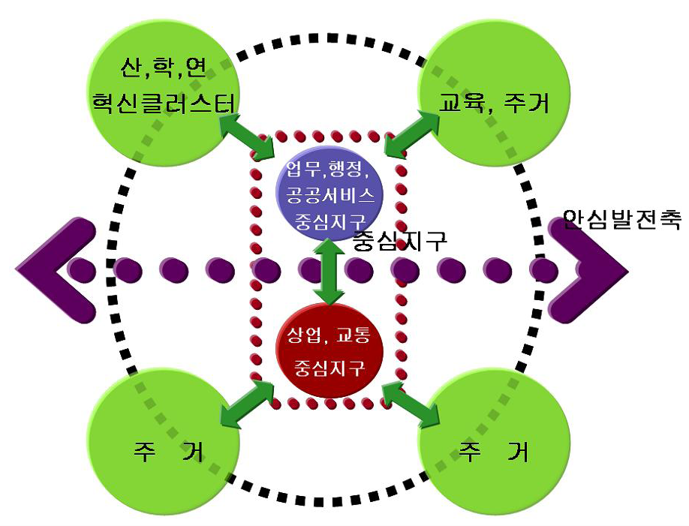
2. High Plan and Associated plan
2015 Dong Gu Long-term Development Plan
Ansim suburban plan
▌ Regional coordination through the existing
formations of the central districts of town areas’ commercial transport.
▌ Functionality of connecting Innovation City’s existing town areas.
▌ Creation of synergy between Innovation
City and its outskirts.
▌ Formation of housing, education and manufacturing in Innovation City’s rear regions
implication
▌ Considered development of ANSIM urban subcenter cooperation in
target areas.
Innovation city and Ansim region The spatial structure
Notes:
Regional coordination through the existing formations of the central districts of town areas’ commercial transport.
Functionality of connecting Innovation City’s existing town areas.
Creation of synergy between Innovation City and its outskirts.
Formation of housing, education and manufacturing in Innovation City’s rear regions.
Considered development of ANSIM urban subcenter cooperation in target areas.

Slide 10
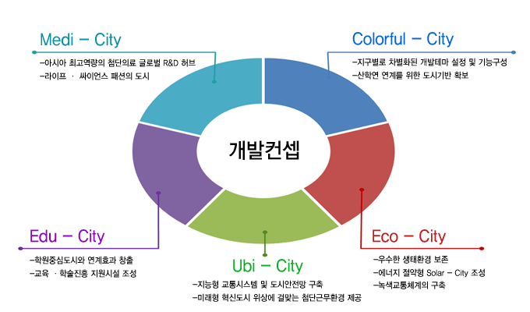
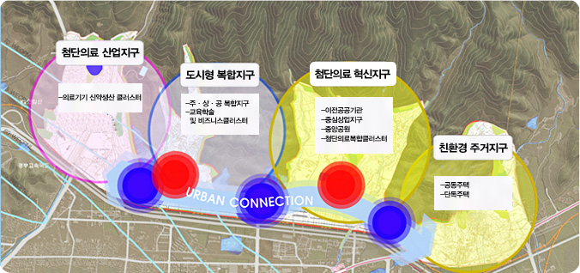
2. High Plan and Associated plan
2015 Dong Gu Long-term Development Plan
sinseo Innovative city construction
▌ Development model – development of new urban terrain
▌ Innovation central region, industry spearhead of regional culture, leisure; spatial organization of residence and greenery.
▌ Creation of reformation of clusters of strategic placement.
implication
▌ Considering the development of linkages with the Innovation city
Notes:
Development model – development of new urban terrain
Utsusemi-shi central region, industry spearhead of regional culture, leisure; spatial organization of residence and greenery.
Construction of separate cluster of functionality for industry, schools, research, government administration office to individualistically plot the shape of the Earth.
Creation of reformation of clusters of strategic placement.

Slide 11
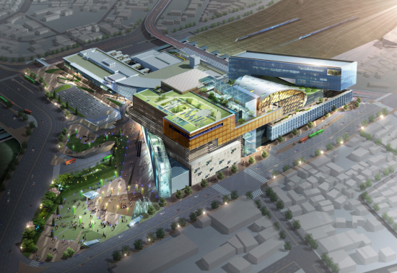
2. 상위 계획 및 관련 계획
2015 동구장기발전계획
동대구 광역복합환승센터
▌ present condition
KTX, intercity bus, local bus or
taxi is exploit in one place
Role as a landmark of Daegu
▌ implication
Transfer Station and the social and economic activities as diverse as construction of Station area
Station the role as a new city landmark

Slide 12
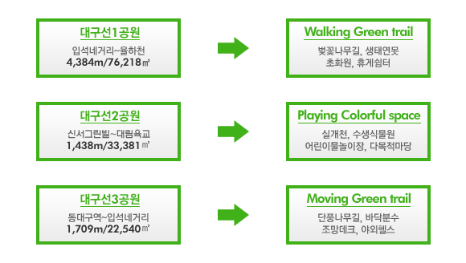
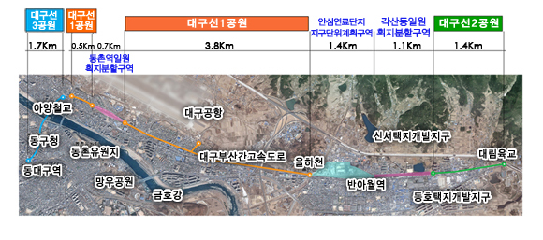
2. High Plan and Associated plan
2015 동구장기발전계획
대구선 공원 조성
Implication
▌ By creating Daeguseon park, the way you want to walk the city composition
▌ Ensuring a clean city image

Slide 13
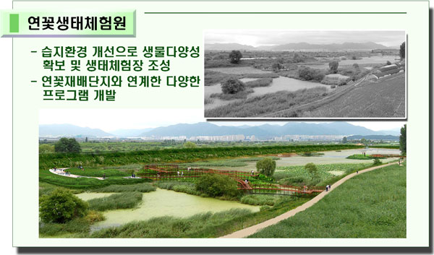
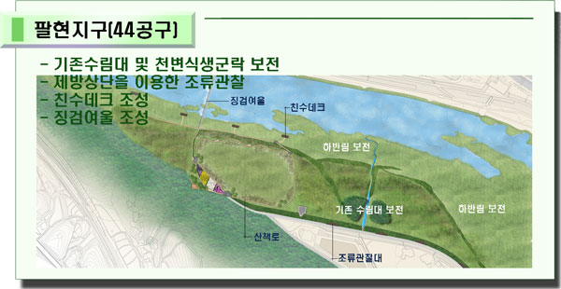
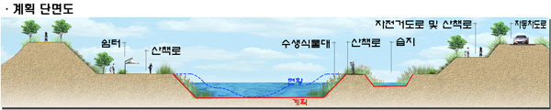
2. High Plan and Associated plan
2015 Dong Gu Long-term Development Plan
Geum-ho River ecology creation
Implication
▌ Composition of ecological environment space around Kumho river connect with an Kumho river ecological space
▌ Biodiversity secure and comfortable environment secure for citizens

Slide 14
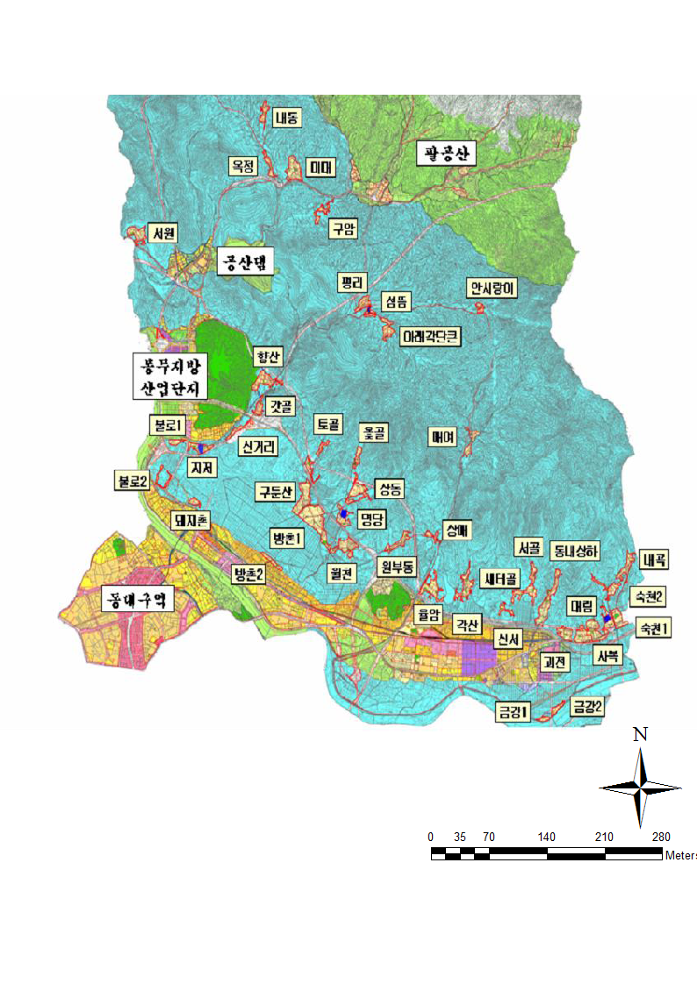
2. High Plan and Associated plan
Related sectoral plans
▌Present condition
Difficulty pursuing land-use efficiency and reorganization of spatial structure.
▌Orientation of development and growth
Review of the establishment of developmentally regulated regions and overlapping regulations.
Areas understood valid for relief of developmentally regulated regions.
▌implication
Development of regulations limiting residents to dismantle a wide range of environmental, public facilities established to meet the diverse needs
개발제한구역 해체위치도

Slide 15
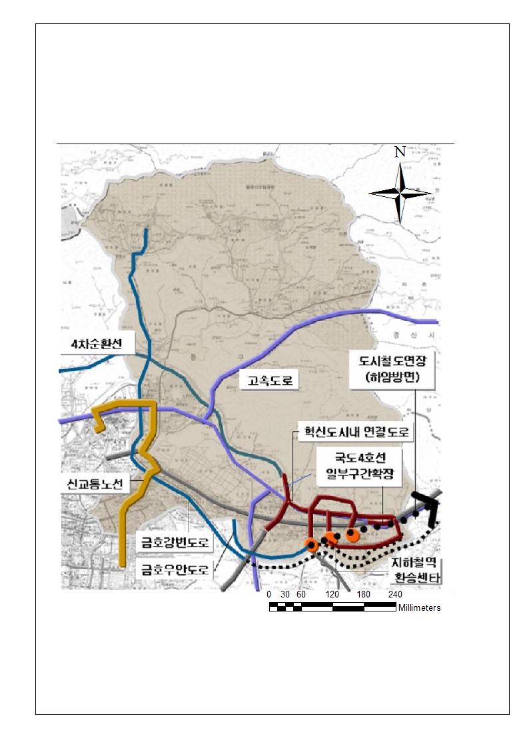
2. High Plan and Associated plan
Related sectoral plans
▌Present condition
Need to create an environment for smooth and comfortable transport.
Lack of parking compared to large number of vehicles owned.
▌Orientation of growth
Expansion of roads; improvement of driving environments.
Improvement of parking environments.
▌implication
District road maintenance
Planning for parking space
동구 도로망 건설 및 환승센터 구상

Slide 16
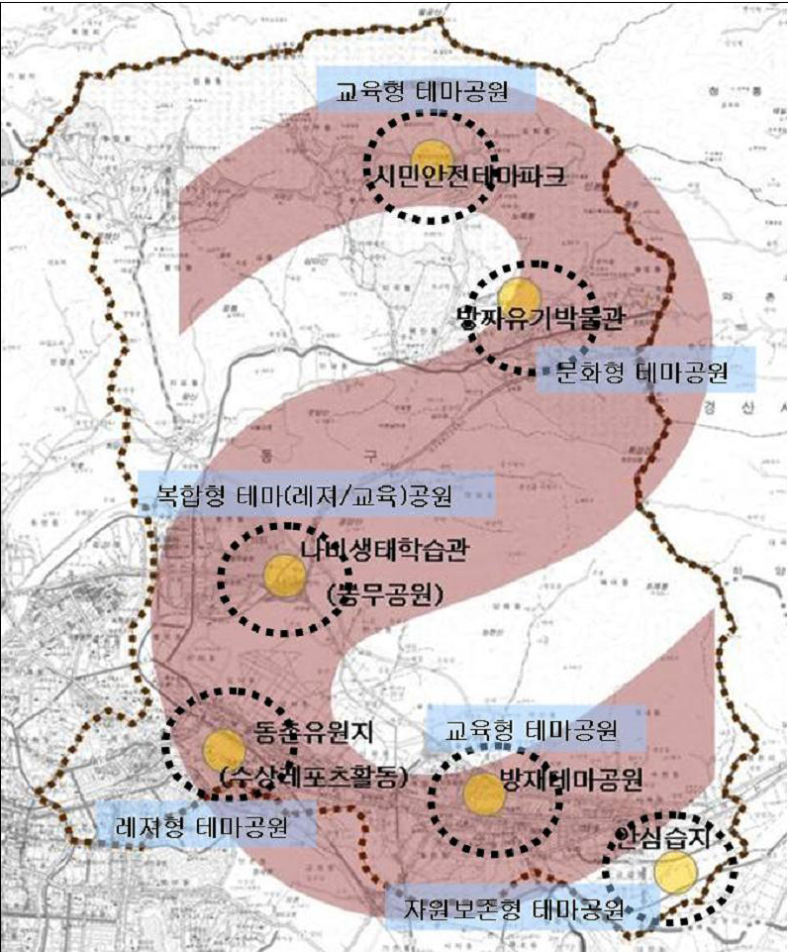
2. High Plan and Associated plan
Related sectoral plans
▌Present condition
Difficulty in Daegu of construction restraints and environmental protection in establishing a foundation for the touristic development focused on improving its weak point of incredibly low outside recognition as a tourist city.
▌Orientation of growth
Stimulation of the creation of Mt. Palgong tourist belt and coordinating tourist commodities.
▌implication
Geumgangdong to develop a wetland ecological park and improve the amenity of residents
테마 문화 관광공원 구상

Slide 17
3. Site Analysis

Slide 18
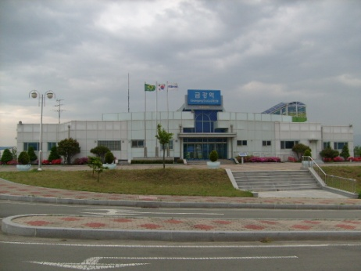
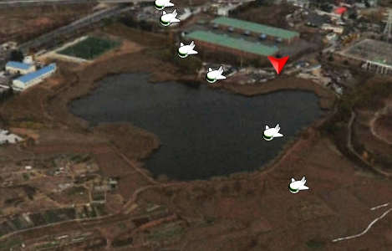
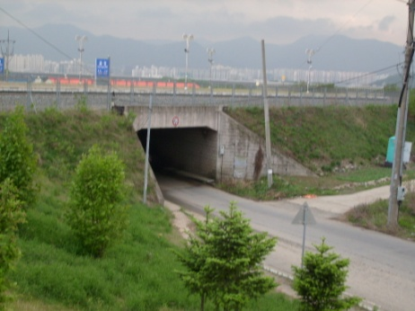
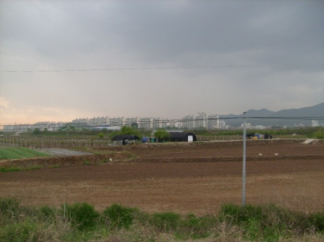
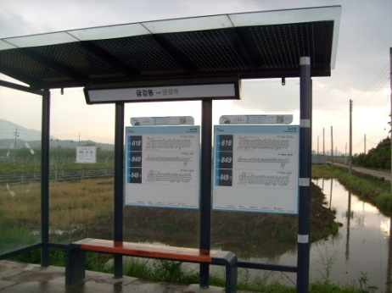
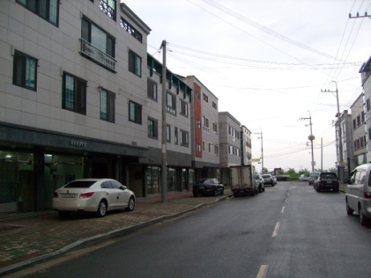
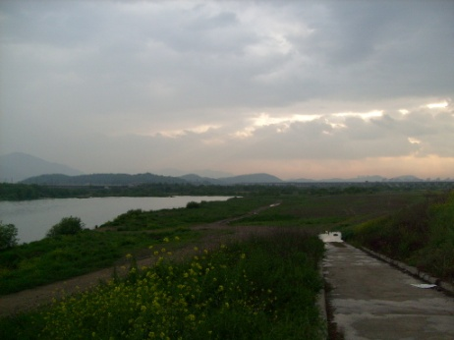
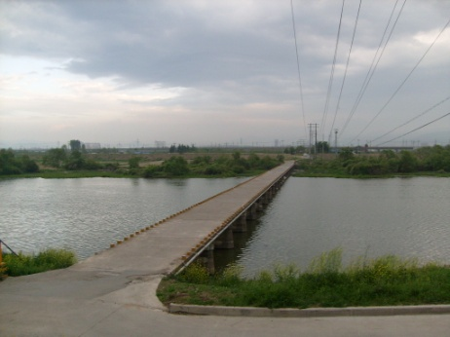
3. Site Analysis
A field study

Slide 19

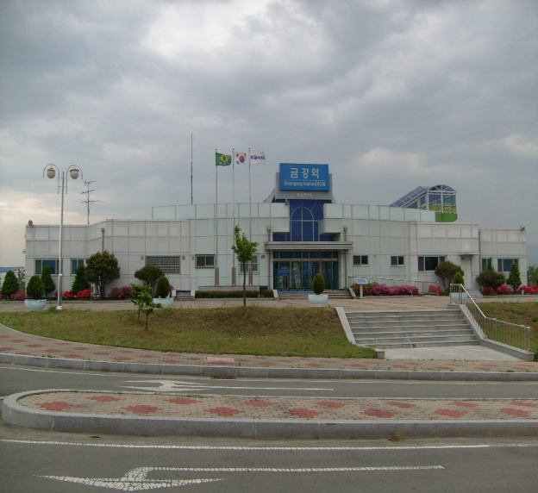
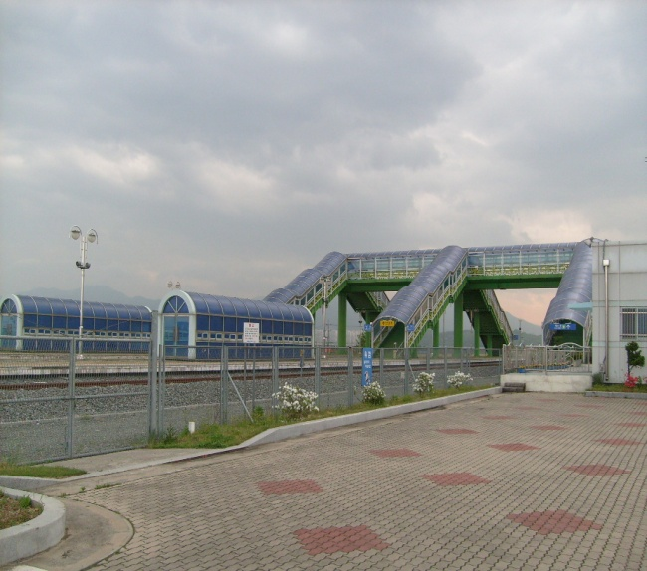
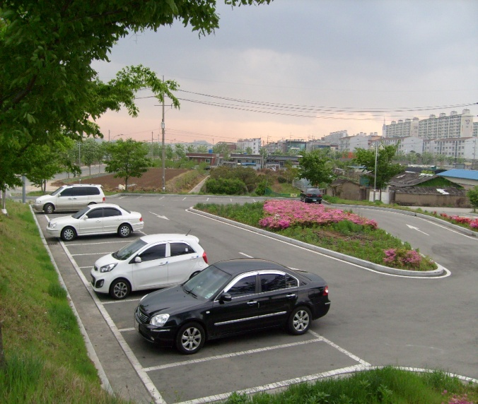
3. Site Analysis
Present condition
Geumgang Station
▌ Geumgang Station is currently available
a nonstop Station
▌ Noise caused by railroad
Geumgang Station
Viaduct
Parking lot

Slide 20
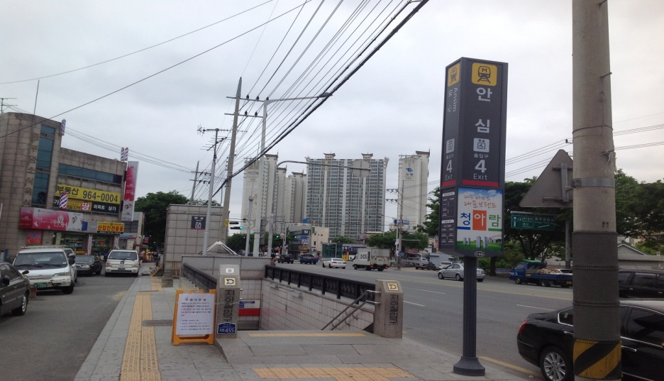
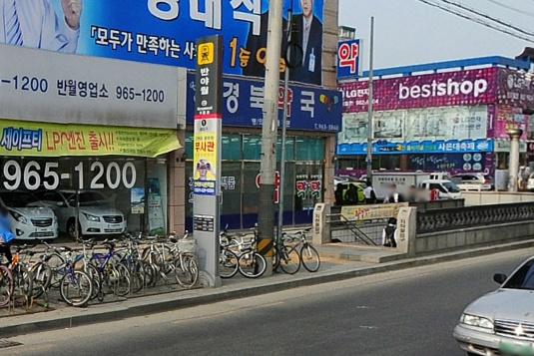
3. Site Analysis
Present condition
Subway stations
▌Ansim station and banyawol station including in development area
▌Utilization of two subway station
Ansim Station
Banyawol Station

Slide 21
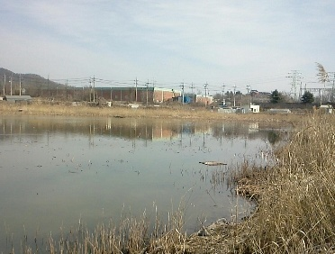
3. Site Analysis
Present condition
Ganam reservoir
▌ That is located south of ansim station ganam reservoir is currently used primarily by anglers
▌As a Ecological Park Utilization
Aerial Photo
Foreground

Slide 22
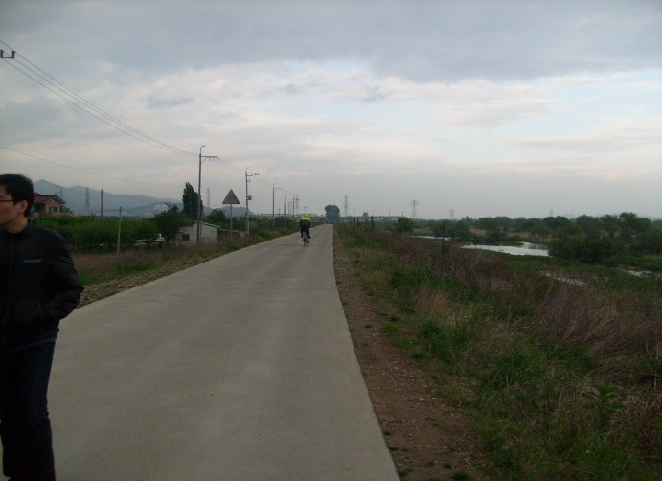
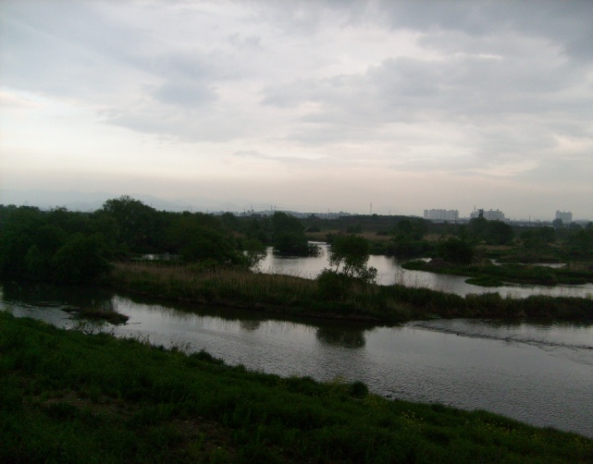

3. Site Analysis
Present condition
Geumho river Dike Road
▌ According to Geumho river that has Dike Road
▌Use of the leisure activities for residents
Dike Road
Guemho Riverside
Wetland

Slide 23
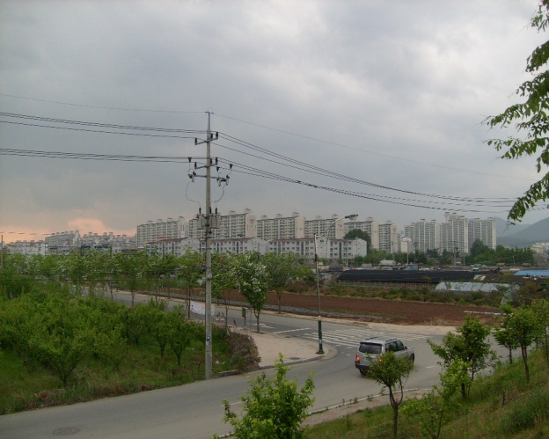
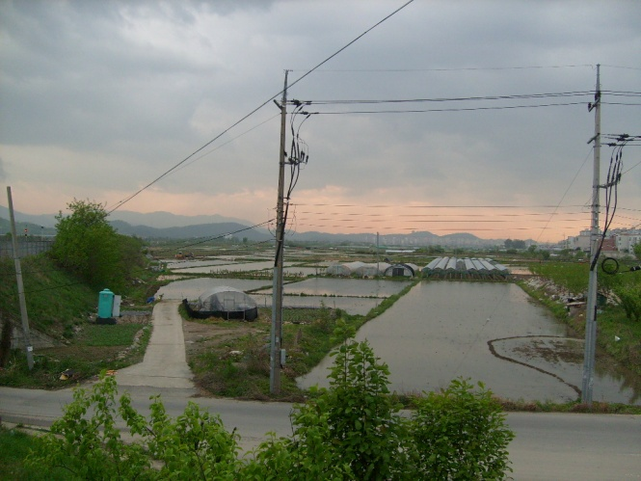

3. Site Analysis
Present condotion
Around Geumgang station road condition
▌ Access road – Four lanes
▌ The remaining roads– 1~2 lanes
Access road
District road
Tunnel

Slide 24
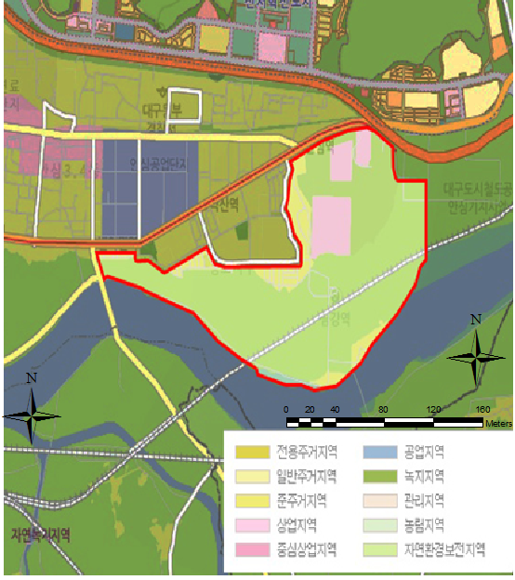
3. Site Analysis
Zoning

Slide 25
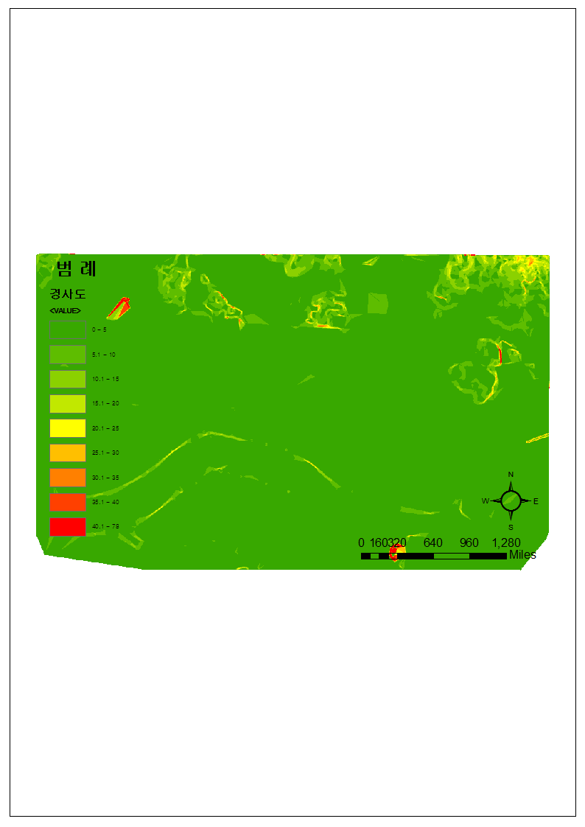
3. Site Analysis
Slope
→ The development site most of slopes 5% or less

Slide 26
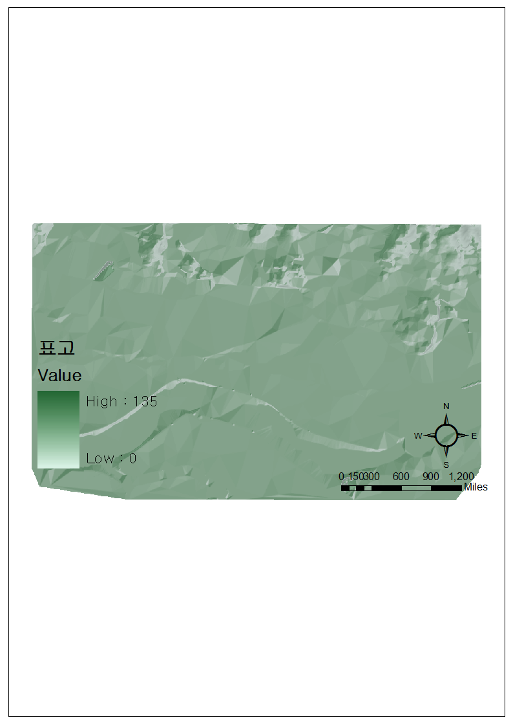
3. Site Analysis
Elevation
→ Development site elevation is the most of 100m or less

Slide 27
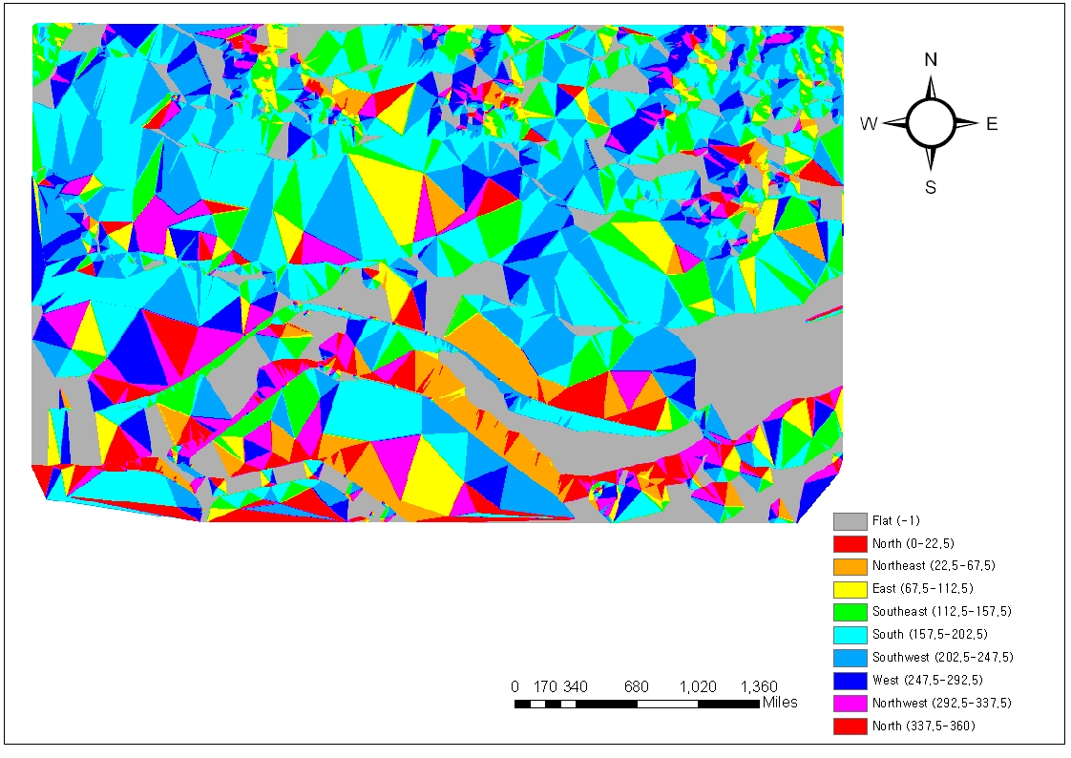
3. Site Analysis
Direction
→ Most of the south facing.

Slide 28
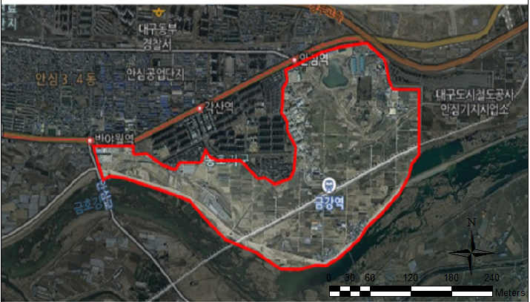
3. Site Analysis
Stream

Slide 29
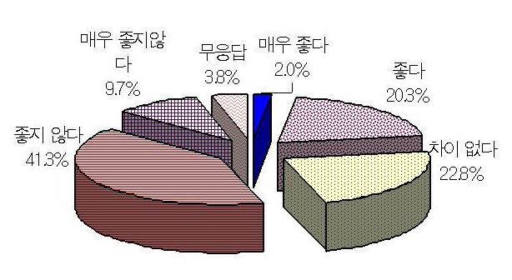
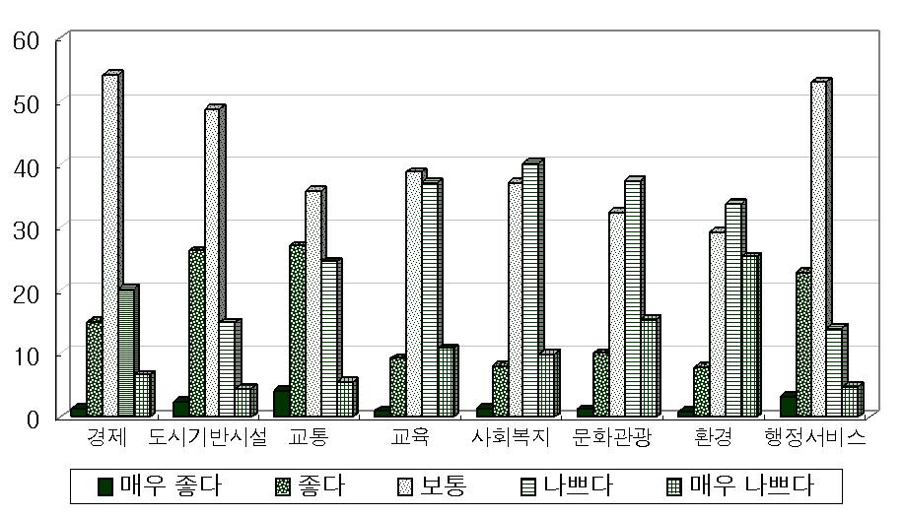
3. Site Analysis
Residents staus
- Most of residents have complained about living conditions.
Implication
1. Need to improve the overall living environment
2. Expansion of education, social, cultural facilities and the
enviromental sector requires improvement

Slide 30
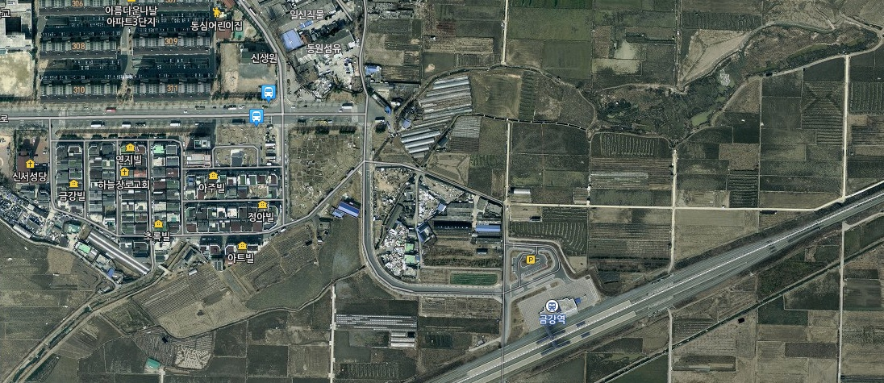
3. Site Analysis
Transportation
▌ Present condition
.
Lack of transportation systems within the district
Implication
By extending the Kum-kang road, and the Kum-kang station
need to linked.

Slide 31
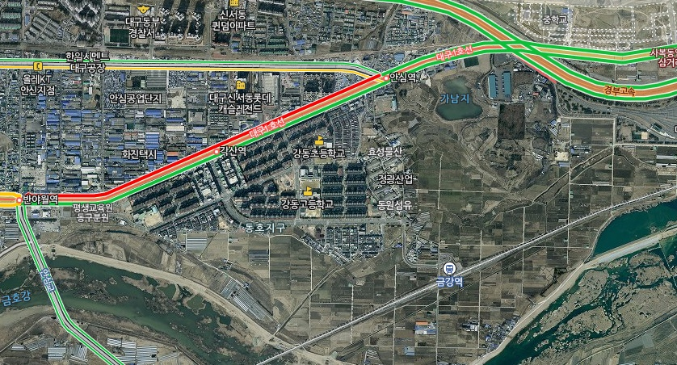
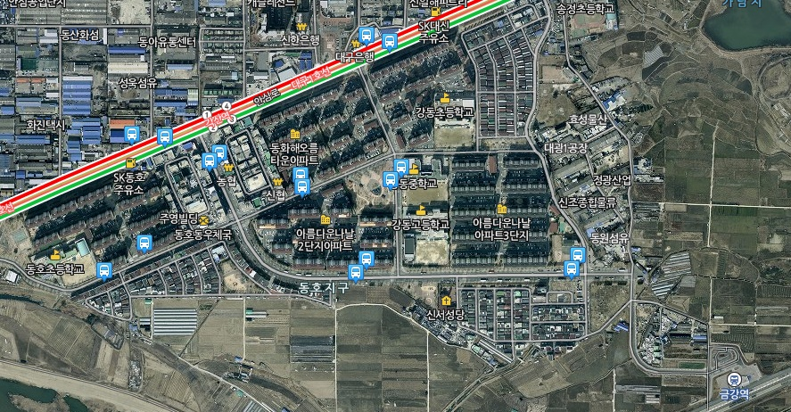

Transportation
▌ Present condition
Insufficient of the road system in development area
Implication:
Need to create a variety of transportation systems
considering connection Kum-kang station with the subway

Slide 32
3. Site Analysis
Conclusions
Lack of cultural life and amenity space
There are many development restrictions because of the various regulatory
Geumgang Sta. lack of utilization
Site

Slide 33
4. Case Study

Slide 34
4. Case Study
1. Geumgang Sta. lack of utilization
2. Lack of cultural life and amenity space
There are many development restrictions
because of the various regulatory

Slide 35
Problem .1 Geumgang Sta. lack of utilization
Two problem
1-1. Lack of transportation systems in the district
1-2. Lack of infrastructure around the station

Slide 36
4. Case Study
Problem. 1 Geumgang Sta. lack of utilization
Case studies 1-1
Case studies 1-2
Greenbelt Station
Yong-san station
Rockingham
Makuhari station
Notes:
금강역 활용도 미비
(마쿠하리, 용산역, 교토, 메트로 그린벨트
철도선 소음 및 시가지 분리 현상 야기
(로코아일랜드,
지구내 도로 기반시설 부족
(록킹햄, 홍콩역, 꾸리찌바
주민들의 문화 생활 및 어메니티 부족
(벤쿠버, 퀠른, 투어강, 함마라비
개발제한구역 상수원 보호구역 개발규제지역 과 같은 제한이 많음
(조지아주 애탈랜타, 독일 엠셔파크, 캐나다 나이아가라

Slide 37
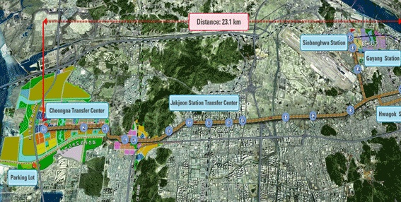
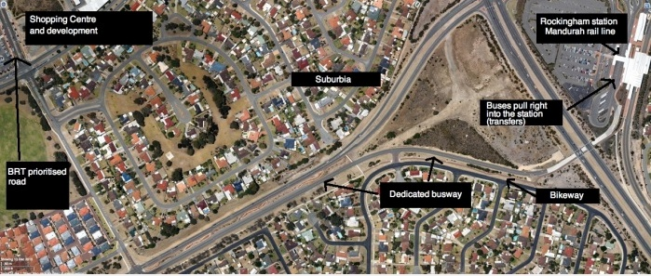
4. Case study
▌Problem 1-1. Case study about Lack of transportation systems in the district
Rockingham (B.R.T)
▌ Capacity of the railway, comfort and speed combined with a bus stop to provide optional flexibility
▌ Implication
City bus and bus routes in the district by establishing In Geumgangdong
provides optional flexibility to passenger

Slide 38
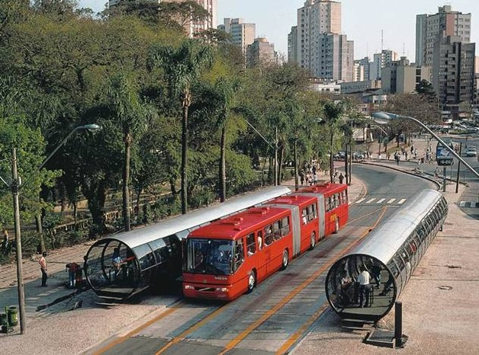
4. Case study
▌Problem 1-1. Case study about Lack of transportation systems in the district
Rockingham (B.R.T)
▌ Installation of the short bus routes
▌ Implication
Operated various bus routes to attract more passengers around Geumgang station

Slide 39
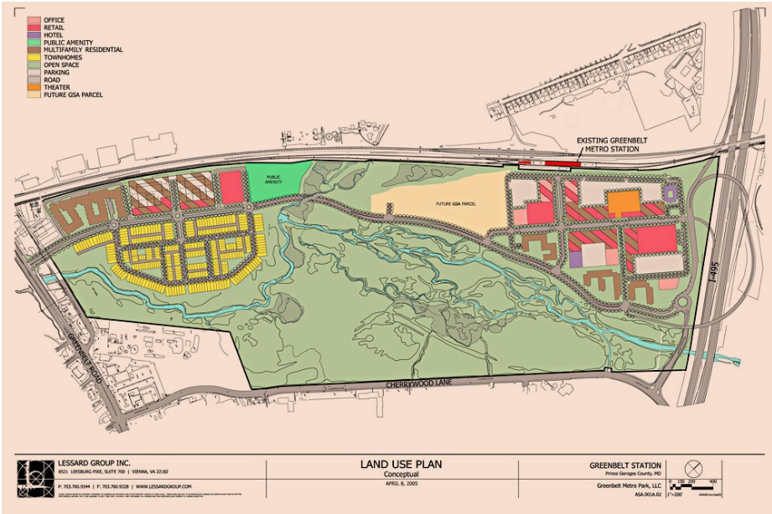
4. Case study
▌Problem 1-1. Case study about Lack of transportation systems in the district
Greenbelt Metro Station
▌ Concentrated the bus stop installation around Station area
▌ Classified as city buses and intercity bus
Implication
▌ for the use of the active Station area connection with bus system

Slide 40
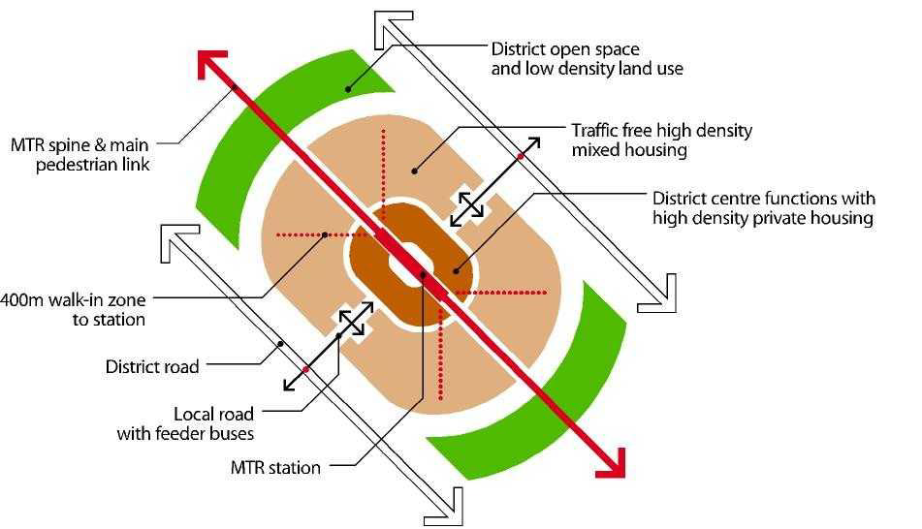
4. Case study
▌Problem 1-1. Case study about Lack of transportation systems in the district
Hong-kong station
▌Feature
Public transit oriented area - activity of station influence area
Outside the beltway – Vehicle handling through the detour and to pass

Slide 41
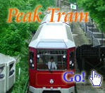
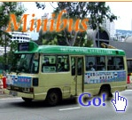
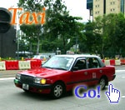
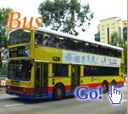
4. Case study
▌Problem 1-1. Case study about Lack of transportation systems in the district
Public Transportation Hong Kong boasts an excellent public transport network, so it's very easy to get around Hong Kong.
▌ Implication
1. The traffic system connection with road system of Dong-gu District
2. Transit-oriented Road System Establish around transit station area

Slide 42



4. Case study
▌Problem 1-2 Case study about Lack of infrastructure around the station
Makuhari station
▌Feature
Business Features
New Urban Development system + Station Area Development ( mix-use )
▌ Implication : < the Activation Plan around Station area >
For the residents the construction of various public facilities around station

Slide 43
4. Case study
▌Problem 1-2 Case study about Lack of infrastructure around the station
Makuhari station
▌Feature
Business Features
Construction of large shopping center based on station square
▌ Implication : < the Activation Plan around Station area >
Commercial building built and office building placement for business functions around station

Slide 44

4. Case study
▌Ploblem 1-2 case study about Lack of infrastructure around the station
용산역
▌ Feature
Station and large commercial facilities that are used in combination
▌ Implication
By using a combination of commercial facilities and Geumgang station,
passengers should be attracted.
By creating a small park in front of commercial facilities, community space
should be created.

Slide 45
4. Case Study
▌Ploblem 1-2 case study about Lack of infrastructure around the station
용산역
▌ Feature
Create a roof garden
▌ Implication
Through a roof garden overlooking the Kumho high view space

Slide 46
4. Case Study
Problem 2 Lack of cultural life and amenity of residents
Two ways
Creation of waterfront with creation of green space
on development area
2. Vibrant spaces creation
Notes:
금강역 활용도 미비
(마쿠하리, 용산역, 교토, 메트로 그린벨트
철도선 소음 및 시가지 분리 현상 야기
(로코아일랜드,
지구내 도로 기반시설 부족
(록킹햄, 홍콩역, 꾸리찌바
주민들의 문화 생활 및 어메니티 부족
(벤쿠버, 퀠른, 투어강, 함마라비
개발제한구역 상수원 보호구역 개발규제지역 과 같은 제한이 많음
(조지아주 애탈랜타, 독일 엠셔파크, 캐나다 나이아가라

Slide 47
4. Case Study
Problem 2 Lack of cultural life and amenity of residents
Case studies 2-1
Case studies 2-2
Canada vancouver
Greenbelt Metro Station
Cologne Media Park
River Tours in Switzerland
Notes:
금강역 활용도 미비
(마쿠하리, 용산역, 교토, 메트로 그린벨트
철도선 소음 및 시가지 분리 현상 야기
(로코아일랜드,
지구내 도로 기반시설 부족
(록킹햄, 홍콩역, 꾸리찌바
주민들의 문화 생활 및 어메니티 부족
(벤쿠버, 퀠른, 투어강, 함마라비
개발제한구역 상수원 보호구역 개발규제지역 과 같은 제한이 많음
(조지아주 애탈랜타, 독일 엠셔파크, 캐나다 나이아가라

Slide 48




4. Case Study
▌Problem 2-1. Lack of cultural life and amenity space
Canada vancouver
▌ Composition of urban green park area greater than 54%
▌ Canada vancouver have many park (Eco-friendly city)
Implication
Designation within the development by creating more green space, eco-friendly urban creation

Slide 49



4. Case Study
▌Problem 2-1. Lack of cultural life and amenity space
Canada vancouver
▌ SEFC Project
Development through efficient linking of city and expert, citizens
▌ Using eco-friendly urban waterfronts
▌ Implication
Effectiveness of Public - Private partnership to maximize the development
Open space creation utilizing the waterfront

Slide 50



4. Case Study
▌Problem 2-1. Lack of cultural life and amenity space
Cologne Media Park
▌ Media park space composition
• City of Cologne and the role of the private sector harmony
오픈 스페이스
▌ Implication
• For creation around ga-nam reservoir in development area is appropriate park concept

Slide 51


4. Case Study
▌Problem 2-2. Lack of cultural life and amenity space
Greenbelt Metro Station
▌ By installing pedestrian and bicycle paths to riverside, openspace offer
▌Implication
Bicycle and pedestrian-oriented network and circulation system of roads built along the Kumho river

Slide 52



4. Case Study
▌Problem 2-2. Lack of cultural life and amenity space
River Tours in Switzerland
▌ Ecology recovery and human and nature harmonization
▌ Improvements habitat space in stream
▌ Creating ecology amenity spaces
Implication
Using cases that eco-friendly, comfortable space of riverside in connection with leisure area
Green space composition with biking road composition on the riverside

Slide 53



▌Problem 2-2. Lack of cultural life and amenity space
Hong-kong station
The side roads in the district – Creating Pedestrian and bicycle space
cycling would enliven between its different nodes of activity
cycling has become enthusiastically promote it as a healthy, ecologically-friendly form of transport
Implication
Pedestrians and cycling roads space is planning sidewalk in the district
..

Slide 54
4. Case Study
problem . 3 Railroad noise and urban segregation
Two problem
problem 3-1 Railroad noise
problem 3-2 segregation of land use
Notes:
금강역 활용도 미비
(마쿠하리, 용산역, 교토, 메트로 그린벨트
철도선 소음 및 시가지 분리 현상 야기
(로코아일랜드,
지구내 도로 기반시설 부족
(록킹햄, 홍콩역, 꾸리찌바
주민들의 문화 생활 및 어메니티 부족
(벤쿠버, 퀠른, 투어강, 함마라비
개발제한구역 상수원 보호구역 개발규제지역 과 같은 제한이 많음
(조지아주 애탈랜타, 독일 엠셔파크, 캐나다 나이아가라

Slide 55
4. Case Study
ploblem . 3 Railroad noise and urban segregation
Case studies 3-1
Case studies 3-2
경의선 구간
Lokko Island
Notes:
금강역 활용도 미비
(마쿠하리, 용산역, 교토, 메트로 그린벨트
철도선 소음 및 시가지 분리 현상 야기
(로코아일랜드,
지구내 도로 기반시설 부족
(록킹햄, 홍콩역, 꾸리찌바
주민들의 문화 생활 및 어메니티 부족
(벤쿠버, 퀠른, 투어강, 함마라비
개발제한구역 상수원 보호구역 개발규제지역 과 같은 제한이 많음
(조지아주 애탈랜타, 독일 엠셔파크, 캐나다 나이아가라

Slide 56


▌Problem 3-1. Case study about Railroad noise
Gyeong-ui railway
Barrier Tunnel type is made if the sound wall is do not adequate protection about noise .
From the baekma station to tanhyeon station, Tunnel type sound wall are made for the prevention of noise
Implication
By constructing tunnel type barrier noise reduce around Geumgang station.

Slide 57


4. Case Study
▌Problem 3-2. Case study about segregation of land use
Lokko Island
Present condition
As complex urban with Housing, business, commercial, education, culture function
▌elevating of railway
elevating of railway and Creating the park under railway
Implication
noise reduce around Geumgang station and for land use more efficiently by elevating of railway land

Slide 58


4. Case Study
▌Case study about Energy-saving city
Hammarby Sjӧstad
▌ Using rainwater secured hydrophilic space of the central garden and installed artificial channel
▌ Residential complex consist of eco-friendly residential complex by placing 'water space → waterfront structures → green space → residence building'

Slide 59



4. Case Study
▌Case study about Energy-saving city
Hammarby Sjӧstad
▌ Implication
Applied hydrophilic and resources circulation models
Green city model fit to local features to create and variety of spread
Built to Resource Recycling Urban

Slide 60
5. Goals and Objectivs

Slide 61
5. Goals and Objectivs
The primary goal
▌Dynamic city
Vibrant city
▌Green City
Clean and environmentally friendly city
▌Community City
city that can accommodate a variety of social stratum

Slide 62
5. Goals and Objectivs
1. Dynamic city
▌ The diversity of street system
TOD development way oriented public transport system
Creating pedestrian and bike road
Diversity improve through Using a complex land use
▌Using complex land use for diversity
According to multi-functional accommodate
a balanced development of the city
linked of residential, commercial and business functions
Provide neighborhood facilities and life comforts facilities to throughout

Slide 63
5. Goals and Objectivs
2. Green City
▌Eco-friendly city
Ecological park
- Green axis connection with the Kumho river in district
▌ Energy-saving city
Reduce air pollution caused by vehicular traffic mitigation and energy conservation
- The inhibition of carbon through Waste management
Renewable Energy Utilization

Slide 64
5. Goals and Objectivs
3. Community city
▌Creating open space
- Square creation In front of Station
- The main commercial and business facilities installed pedestrian deck
- Barrier-free environment creation
▌ Diversification of the residents exchange space
Culture and Sports Facilities supply such as Welfare Hall, libraries,
riverwalk, riverside park
Courtyard block build

