Slide 1
Republic Of Korea
21107606 choi jae-hyung
Public-administration

Slide 2

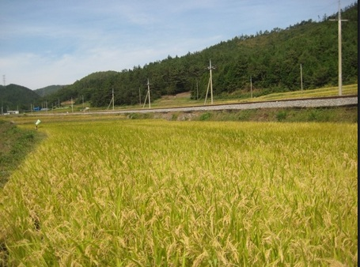
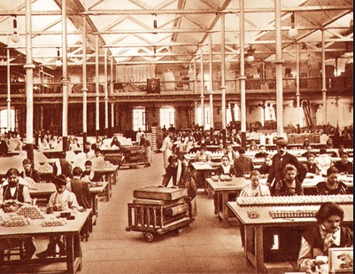
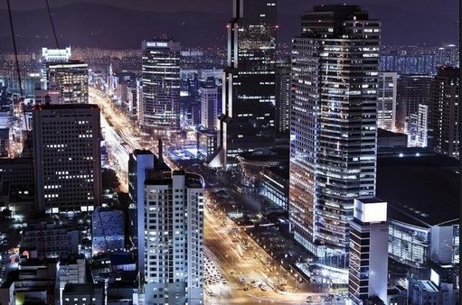
Introduction
Republic of korea’s political flow
-> ->
>

Slide 3
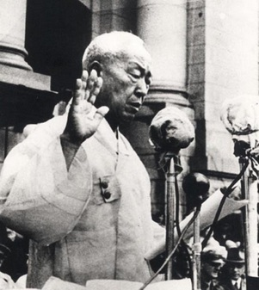
State-Building(1948~1960)
Rhee Syng-Man
Rhee
direct-elected position
eight-year term limit

Slide 4
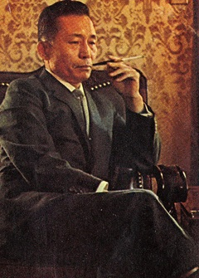
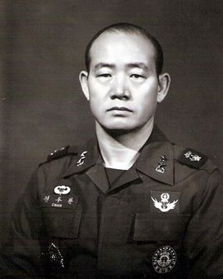
Developmental Stage(1961~1979)
Park Chung-Hee
'emerging from extreme poverty and reducing
immediate human sufferings'.
'growth-first developmental policy'
Chun Doo-Hwan
social justice, welfare state,
and small government

Slide 5
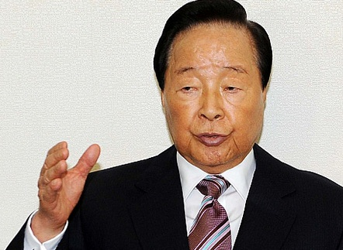
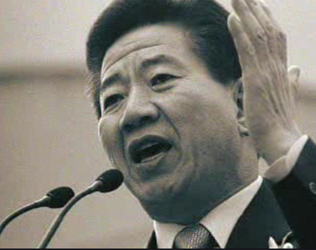
Democratization(1980~2007)
Kim Young-Sam
"reform from the top"
Roh Moo-Hyun
social welfare
“politic for people”

Slide 6
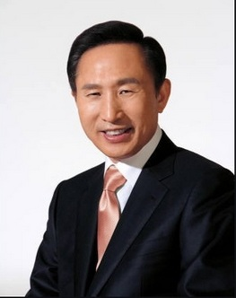
Advancement(2008~Present)
Lee Myung-Bak
“values of pluralism, individuality, and creativity.”
“promotion of qualitative growth”

Slide 7
Thank You

