Slide 1

Introduction
Department : Public Administration
Student identification number : 21107619
Name : Kwon Hee Su

Slide 2

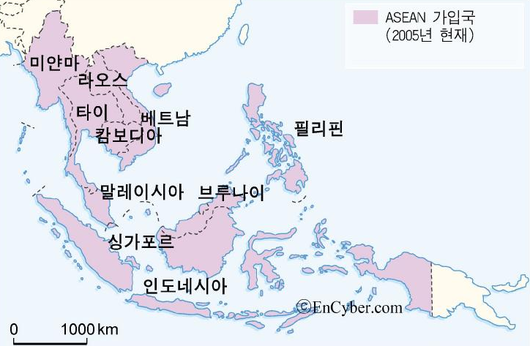
ASEAN
ASEAN
-ASA→Developmental dissolution
→ASEAN established on Aug. 8, 1967
-Founding member country : 5 member countries
Philippines, Malaysia, Singapore, Indonesia, Thailand.
-Today : 10 member countries
Brunei Darussalam joined ASEAS on January 8, 1984,
Viet Nam, Lao PDR and Myanmar, Cambodia.
-Purpose : Improvement of living standards

Slide 3


ASEAN + ROK
·Brunei Darussalam
·Cambodia
·Indonesia
·Lao PRD
·Malaysia
·Myanmar
·Philippines
·Thailand
·Singapore
·Viet Nam
·Republic of Korea

Slide 4
Sum
·Public administration and public governance in
ASEAN member countries and ROK are rapidly
developing and moving forward.
·Developing countries is, without fully independent
assessment of the reality.
·Developing countries select reform measures,
it is necessary to realistically review or analyze the nature.

Slide 5

Thank You

