Slide 1
public administration 21107460 shin na ra
Lao PDR
Lao People’s Democratic Republic

Slide 2
content
Introduction
Administration in Lao PDR
-central & Local administration
-Features of administration
Conclusion

Slide 3
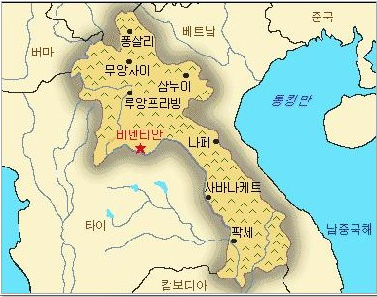
Introduction
La0 is People’s Democratic Republic.
Lao is a landlocked country in South East Asia.
Lao is made up of 70% mountains.
Lao capital is Vientiane.
The population of Lao is made up of young people.
Lao is divided into 49 multi-ethic.

Slide 4
Administration in Los PDR
Central & local administration
Features of administration
The government consist of a the national assembly.
the government has broad executive responsibilities.
President of Republic
-to promulgate laws
-to appoint or remove the Prime Minister and members of government
District Chiefs
-implement development plans
-coordinate activities of field offices of the line ministries in the district.
When it comes to decision-making, Lao political institution and public organization comply with the principles of centralized.
The civil service in Lao is classified into five grades.
The government has encouraged civil servant to upgrade their educational qualifications.
the government has put in place several regulation and frameworks
-to support substantive and sustainable change
-concentrating on improving the role, functions, duties and organization structure

Slide 5
Conclusion
The reforms and changes remain a number of significant challenge.
-between service delivery and improved administration and enhanced reality policy.
-there is need for more effective local level planning and service.
-there is need to devise systems improvement initiatives .

Slide 6
Thank you.

