Slide 1
Viet Nam
Department : Public Administration
Student number : 21107761
Name : 조은아

Slide 2
Contents
Introduction
Major Economic Trends Ⅰ
Major Economic Trends Ⅱ

Slide 3
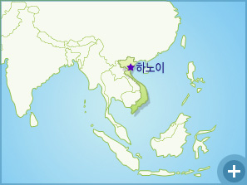
Introduction
Location : Located in the eastern part of Indochina.
Capital : Hanoi
Language : Vietnamese
Population :Approximately 86,120,000 people.
GDP : 1174 $

Slide 4
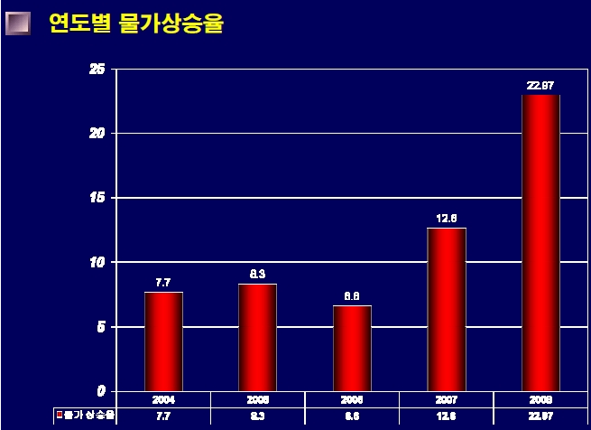
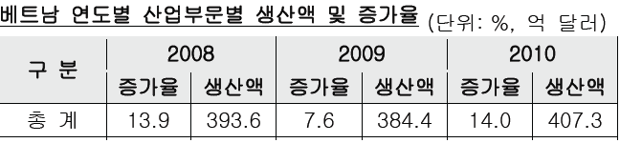
Major Economic Trends Ⅰ
Vietnam's inflation rate.
Material price increases.
Increase in money supply.
Industrial production growth rate.
World economic recovery.
Exports and market demand.

Slide 5
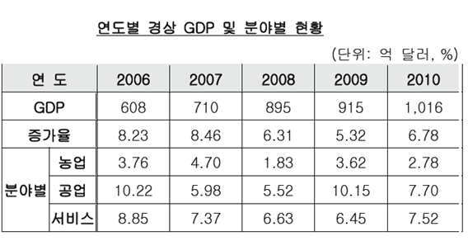
Major Economic Trends Ⅱ
China, India, the next higher GDP growth.
GDP growth rate.
Corporate loans and support , Industrial
competitiveness recovery.
Since 2006, the industrial sector led economic growth.

Slide 6
Thank you!!

