Slide 1

LET`S GO !
PHILIPPINES
Department : Administration
Student number : 21107758
Student name : Lee Sun A

Slide 2
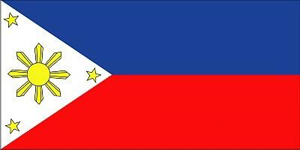
Administrative district
National name : Republic of the Philippines
Simply : Philippines
Administrative Organization
17 Region
80 province
117 city
1,501 municipality
41,982 village
Capital : Manila
Form of government : republicanism
Standard time : UTC(Universal Time Coordinated) + 8
Legal system
: Spain and English and American legal system is based on.

Slide 3
Position
Frequent earthquakes
and Typhoon
But
Abundant natural resources
And Biodiversity
North : Taiwan
West : Vietnam
South : Indonesian islands
East : Philippine Sea
Thus
Population
Approximately 94 million people
12th in the world`s most populous nation
Approximately 11 million people living abroad
Language
Language : Tagalog
Official Language : Tagalog, English
Mother tongue : Total 172
Besides Chinese, Spanish, Creole, Arabic, etc.

Slide 4
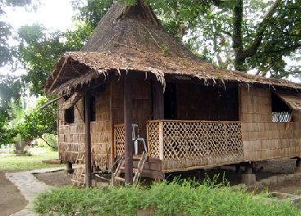
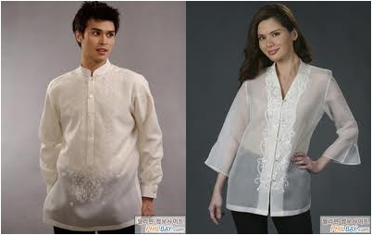
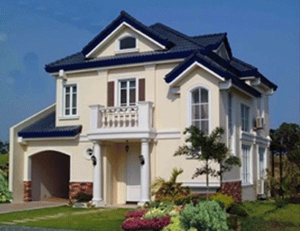
Culture
Clothes
Man - Barong Tagalog
Women - Baro't Saya
Dwelling
A traditional house
A modern house
Food
Without specific diversity.
because of food is mixed different many countries.

Slide 5
Thank you
For my stories.
Bye bye ~!
0(^.^)0

