Slide 1
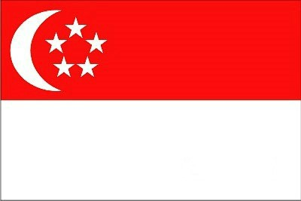
SINGAPORE
21107473
U JUN HO

Slide 2
Governance Structure

Slide 3
Bureaucracy

Slide 4
Fine Country

Slide 5
THANK YOU!

