Slide 1

Lao PDR
: Lao People's Democratic Republic

Slide 2
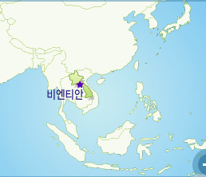
The Lao People’s Democratic Republic is a landlocked country in South East Asia, surrounded by Thailand, Myanmar, China, Vietnam, and Cambodia. Divided into sixteen provinces with Vientiane, the Capital City, Lao PDR has a land area of 236,800 square kilometers.
With a population of 5.62 million inhabitants, Lao PDR has one of the lowest population densities in the region

Slide 3
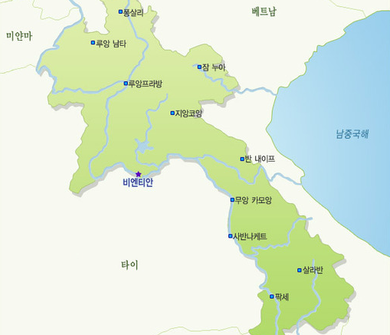
The population, consisting of 2.82 million females and 2.80 million males, grew at 2.1% per annum during the previous decade.
The age-pyramid of Lao PDR reflects a young population as about 40% of the population was below the age of 14 in 2005.
Urban areas take ip less than one percent of the total land area.

Slide 4
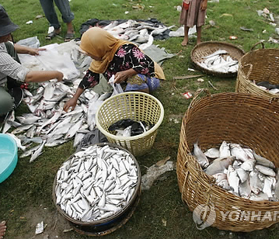
About 70% of the country is mountainous, while the rest of the country consists of the Mekong floodplains and other river valleys.
Forest covers over a third of the country, making it one of the most heavily forested countries in the region. The population is predominantly located in rural areas.
The country has a multi-ethnic population

Slide 5

Thank you

