Slide 1


Indonesia
Department: public administration.
Student number: 21107567.
Name: Park Song E.

Slide 2

Introduction
Capital : Jakarta.
Language : Indonesian.
Population : 245,450,000 people..
Area: 191 ten thousand 9317 ㎞².
Location: the equator of western Indian Ocean and the eastern pacific .

Slide 3
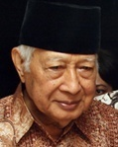
Politics
Suharto
nationalist
MPR
DPR

Slide 4
Military
Army
215,000
Navy
43,000
Air Force
24,000

Slide 5
Diplomacy
Foreign Policy
ASEAN
China has re-education in 90

Slide 6


