Slide 1
Chapter3. Cambodia
21107839
발표자: 김찬미

Slide 2
Table of Contents
Historical Perspective
Cambodia at a Glance
The Cambodian Civil Service
Current public Administration Reform: The Situation
Public Administration Reform: The Vision and the Situation
Performance and Accountability
Conclusion

Slide 3

Historical Perspective
Following years of war and devastation, the Paris Peace Accords were signed in 1991.
Free and fair elections, a necessary first step, were held in May 1993.
Following a national conference on reforming the Civil Service, the Royal Government updated the National Program for Administrative Reform in 2004. The focus was on Serving people Better. The council for Administrative Reform set out to articulate a policy framework and implementation plan to guide the reform into the medium term to support the implementation of the National Strategic Development plan 2006~2010.
After the 2008 elections, with sound and sustainable foundations in place, the reform is currently at a crossroads to further deepen and widen its reach.

Slide 4
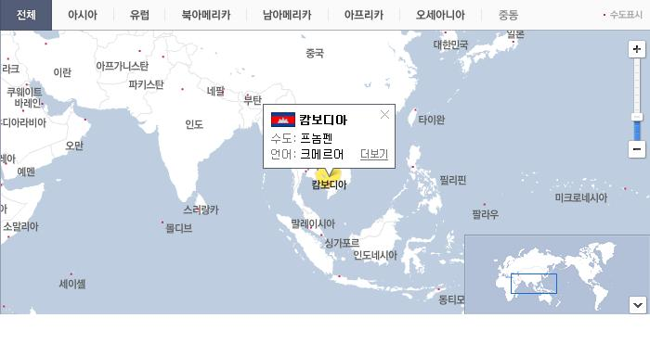
Cambodia at a Glance
The Kingdom of Cambodia is a unitary state and a pluralist democracy.
The National Assembly and the Senate anchor
the Legislative Branch.
Cambodia is a market-based economy. Cambodian areas are divided into 23 provinces and
the capital. Municipalities and Districts are second-level administrative divisions of
Cambodia.

Slide 5
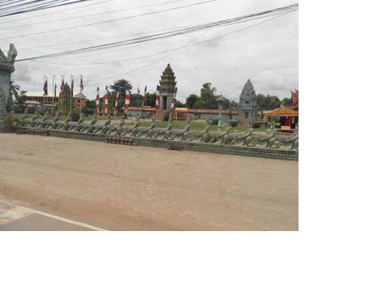
The Cambodian Civil Service
At the national level, the administration is
subdivided into 27 ministries and
some 34 authorities. The Cambodian Civil service is a young institution.
Service is based on a career system whose main characteristics are stipulated in the Common Statute and in 21 Particular Statutes.

Slide 6
Current public Administration Reform: The Situation
Management and control systems are operational and effective.
However, they shall be made more supportive of performance, accountability, and merit. Major complementary
reform programs are underway.

Slide 7
Public Administration Reform: The Vision and the Situation
At the beginning of the Fourth Mandate, the Administrative Reform stands strong but challenges are daunting. secondly, the compensation regime has been made more conducive to performance. Thirdly, management and control systems are operational and effective. Fourthly, there is a broad base consensus on strategy and priorities to deepen the reform. Lastly, major complementary reform programs are underway.

Slide 8
Performance and Accountability
Special Operating Agencies(SOAs): SOA type institutions are being used, with success, as part of reform programs that, much like the Royal Government's strategy, mainly aims to improve the quality and delivery of public services, to enhance performance, and develop human and institutional capacity.
Priority Mission Groups (PMGs): The Royal Government has been deploying PMGs since 2005 to enhance performance. Merit-Based Performance Incentives
(MBPIs): A Sub-Decree provides the legal framework for ministries to design, establish, manage, and monitor MBPI schemes within their jurisdiction. Performance Management and Accountability Systems(PMAS): PMA Systems link ministries strategic and operational plans to work-units and staff.

Slide 9

Conclusion
The approach will be prudent and fiscally responsible, particularly when it comes to the
introduction of incentive instruments and to
improving compensation in the Civil service. Once the National program for Administrative Reform is approved, partnerships involving ministries and development partners will be established to carry out the process
of implementation.

Slide 10
Thank you ~♡

