Slide 1
Brunei Darussalam
Public administration
21107651 Kim Kyung Jin

Slide 2
Contents
Introduction
System of Government
Civil service
Conclusion : Reform and Challenges

Slide 3
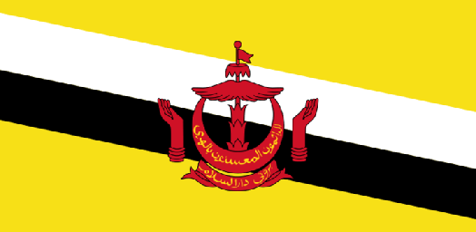
Introduction
- Brunei is a small sultanate situated on the north coast of borneo
- Population : 380,000
( composed Malays, Indigenous chinese, expatriate population)
- High standard of living : GDP per head of US$28,700
(fourth highest in Asia) -> oil and gas
- Brunei has maintained a traditional ascriptive culture
- Strong village culture : kindship, customary deference
- Worship, fasting, and pilgrimage

Slide 4
System of Government
- Brunei is monarchal.
- Executive power resides in the Sultan who is supported by a Council of Minister or cabinet.
- Presently it comprises 29 members, who are either ex-officio members of directly appointed by the Sultan.
- public policy and government administration is a comprehensive program of social protection, as reflected in the priority given to it in the current five year budget projections, and National Housing Development Scheme.

Slide 5
Civil service
- Brunei civil service is divided hierarchically into various schemes of service.
->cross-cutting service : Division1(senior)~5(lowest)
- Appointments and promotion
->by merit, educational qualifications and the extent and type of training undergone.
- They are moved from one post to another, administrative service officers can be regarded as generalists, often dealing with matters in which they do not have a trained specialization.

Slide 6
Conclusion : Reform and Challenges
- While the government of Brunei has delivered stability and prosperity, challenges exist which necessitate adjustment in the role of the public sector and reform of the structure and processes of government administration.
- trim the size and enhance the efficiency of the central bureaucracy
- streamlining of administrative processes and the consolidation of bureaucratic procedures, thus avoiding overlap, duplication, red tape, and wasted resources.

Slide 7
THANK YOU!

